Slide 1

Programming with JavaScript and jQuery
Day 7
Chapter 9:
Managing State Information and Security

Slide 2
Understanding State Information
State information
Information about individual visits to a Web site
HTTP’s original design: stateless
No persistent data about site visits stored
Reasons for maintaining state information
Customizes individual web pages
Stores information within a multipart form
Provide shopping carts

Slide 3
Saving State Information with Query Strings
Query string
Set of name-value pairs
Appended to a target URL
Consists of a single text string that contains one or more pieces of information.
You can use a query string to pass information, such as search criteria, from one web page to another.

Slide 4
Saving State Information with Query Strings
Passing data with a query string
Add a question mark (?) immediately after a URL
Followed by the query string (in name-value pairs) for the information to preserve
Ampersands (&)
Separates individual name-value pairs within the query string
Example:
<a href="http://www.example.com/addItem.html?isbn=9780394800165&quantity=2">Order Book</a>

Slide 5
Saving State Information with Query Strings
The passed query string is assigned to the target web page through the Location object’s search property
search property of the Location object contains a URL’s query or search parameters
<a href="http://www.example.com/addItem.html?isbn=9780394800165&quantity=2">Order Book</a>
From preceding example:
Query string:
"?isbn=9780394800165&quantity=2"
Available as the value of the search property of the Location object after addItem.html document opens.

Slide 6
Parsing Data from a Query String
For a web page to use the information in a query string, your JavaScript program must first parse the string.
Remove the question mark
Do this by using the substring() method combined with the length property.
Example:
// Assign the query string to the queryData variable
var queryData = location.search;
// "?isbn=9780394800165&quantity=2"
// Remove the opening question mark from the string
queryData = queryData.substring(1, queryData.length);
First character in a string has a starting index of “0”, so giving a starting index of 1 will remove the question mark

Slide 7
Parsing Data from Query Strings
The next step is to convert individual pieces of information into array elements.
Using the split() method
Example:
Convert the information in the queryData variable into an array named queryArray[]
// split queryData into an array
var queryArray = queryData.split("&");
You pass the ampersand, because that is the character that separates the name-value pairs in the query string.

Slide 8
Exercise: Eating Well
In the “WA120_data_files” folder, open the folder for “Chapter09”.
Open the “chapter” sub-folder and copy the contents.
Navigate to where you save your projects and create a new folder named “eating_well”.
Paste the copied contents into this folder.
Open the “order.htm”, “order2.htm”, and “results.htm” documents in Notepad ++.

Slide 9
Exercise: Eating Well
Open “order.htm” in a browser and complete the text fields with some information.
Click the NEXT button and the second page will open.
The address displayed in the browser’s address bar includes a query string that incorporates the names and values from the fields on the previous page.

Slide 10
Exercise: Eating Well
Open a new blank document in Notepad ++ and save the file as “script2.js” in the “eating_well” folder.
Enter the code in the instructions given on pages 626-628.
The result is that the info from Order 1 is now stored in the queryArray array which you can check in the browser console. However, only the order 2 data will be submitted if we click next at this point…

Slide 11
Saving State Information with Hidden Form Fields
Hidden form field
Special type of form element that is not displayed by web browsers.
Allows information to be hidden from users
Created with the input element
Temporarily stores data sent to a server along with the rest of a form
No need for user to see hidden data
Syntax
<input type="hidden">

Slide 12
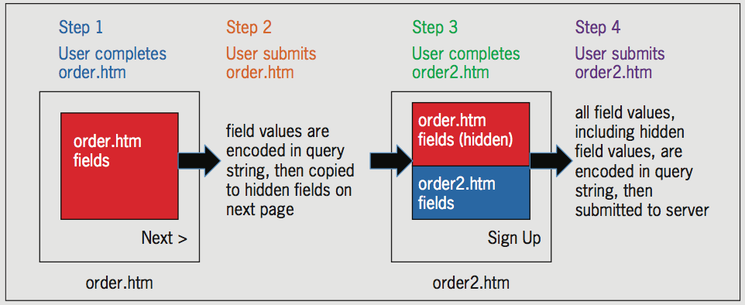
Saving State Information with Hidden Form Fields
Figure 9-7 Submitting data from multiple forms using hidden fields

Slide 13
Exercise: Eating Well
Follow the instructions on pages 629 – 633 which will assign values from the queryArray to the hidden fields so that when users submit the 2nd page of the order form, the data from page 1 as well as page 2 will be encoded in a query string.

Slide 14
Short Quiz 1
How do you reference a passed query string in your code?
How is data in a query string separated from a URL? How are individual name-value pairs distinguished within a query string?
How is a hidden form field different from other form fields?

Slide 15
Storing State Information
Query strings and hidden form fields temporarily maintain state information.
Query strings and hidden form data are lost once a web page that reads the string closes.
Two methods of storing state information on user's computer
cookies
Web Storage (not as widely supported)

Slide 16
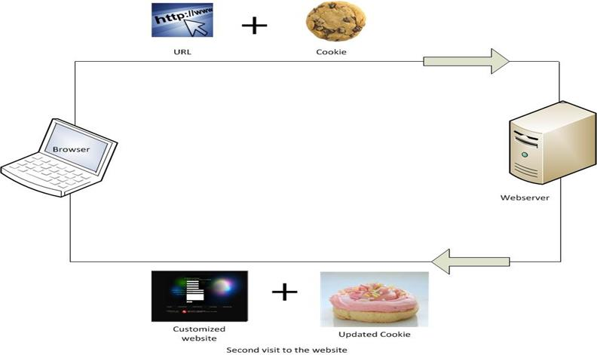
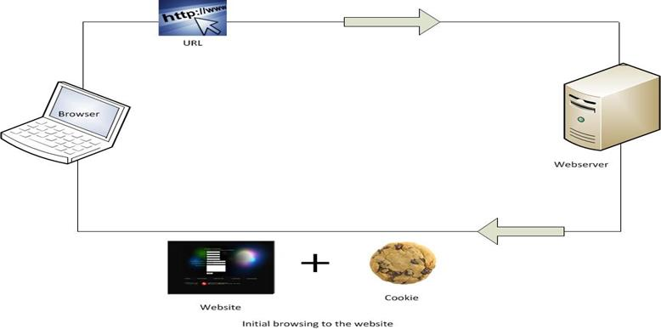
Storing State Information with Cookies
Cookies
Small pieces of information about a user
Stored by a web server in text files
Stored on the user’s computer as text files as well
When web client visits a web server
Saved cookies are sent from client to the server

Slide 17
Storing State Information with Cookies
Temporary cookies
Remain available only for current browser session
Persistent cookies
Remain available beyond current browser session
Stored in a text file on a client computer

Slide 18
Storing State Information with Cookies
Limitations on the use of cookies
Server or domain can store a maximum of 20 cookies on a user’s computer
Total cookies per browser cannot exceed 300
Largest cookie size is 4 kilobytes
Not enforced by all browsers since in modern computing, storage space is not much of an issue compared to the early days of the web.

Slide 19
Creating and Modifying Cookies
Use the cookie property of the Document object
Creates cookies in name-value pairs
Syntax
document.cookie = name + "=" + value;
Cookie property is created with a required name attribute and four optional attributes:
expires, path, domain, secure

Slide 20
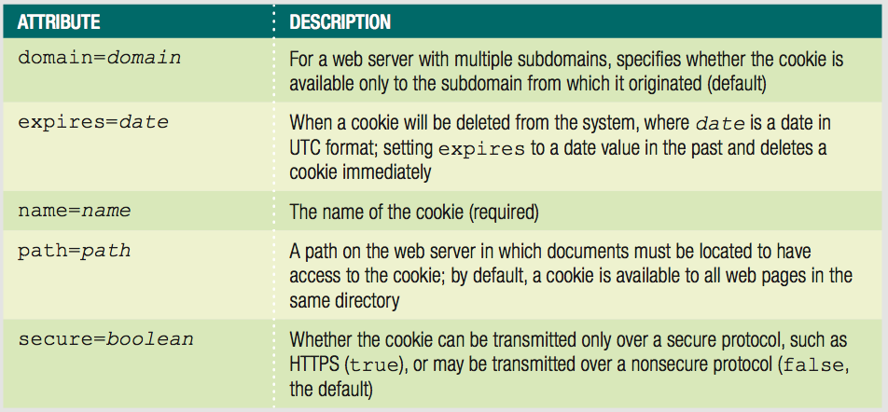
Creating and Modifying Cookies
Table 9-1 Cookie attributes

Slide 21
Creating and Modifying Cookies
The name attribute
This is the only required parameter
Specifies the cookie’s name-value pair
Cookies created with only the name attribute: are temporary cookies.
The cookie property adds another entry to a list of cookies.
Note: This is in contrast to other JavaScript properties which will replace the old value.

Slide 22
Creating and Modifying Cookies
Example: build a list of cookies
document.cookie = "username=mw101";
document.cookie = "member=true";
document.cookie = "audio=false";
Resulting value of cookie property:
username=mw101; member=true; audio=false
A web browser automatically separates each name-value pair in the cookie property with a semicolon and a space.

Slide 23
Creating and Modifying Cookies
By default, cookies cannot include semicolons or special characters such as commas or spaces.
Can use special characters in cookies if using encoding
Encoding involves converting special characters in a text string
Converts each special character to its corresponding hexadecimal ASCII value preceded by a percent sign.
fullname = Mitchell Ward would read as:
fullname=Mitchell%20Ward

Slide 24
Creating and Modifying Cookies
encodeURIComponent() function
Used for encoding the individual parts of a URI
Converts special characters in the individual parts of a URI to corresponding hexadecimal ASCII value
Syntax: encodeURIComponent(text)
Does not encode standard alphanumeric characters (A,B,C or 1,2,3…)
Does not encode the following special characters: -_.!~*’()
Also does not encode characters which have a special meaning in a URI such as: ;/?:%@&=+$
decodeURIComponent() function
Counterpart of encodeURIComponent() function
Syntax: decodeURIComponent(text)

Slide 25
Creating and Modifying Cookies
If you transmit a URI containing spaces using a modern web browser, the browser automatically encodes the spaces for you before transmitting the cookie.
Older browsers do not automatically encode spaces or recognize certain special characters unless they are encoded.
For these reasons, you should manually encode and decode cookies using the encodeURIcomponent() and decodeURIcomoponent() functions.

Slide 26
Creating and Modifying Cookies
Testing Applications That Use Cookies
Browsers open local documents without HTTP
Some browsers don't support setting cookies when HTTP protocol not used (like Chrome)
Can focus testing on browsers that support cookies on files opened without HTTP
More robust option
run local web server
open files using HTTP protocol
some code editors include built-in testing server

Slide 27
Exercise: Eating Well
Enter the code on pages 639-642 to enhance the “script2.js” file to create cookies containing the form field names and their values.

Slide 28
Setting Cookie Expiration Dates
expires attribute
Determines how long a cookie can remain on a client system before being deleted
Cookies created without this attribute are available for the current browser session only.
Syntax: expires=date
name-value pair and the expires=date pair separated by a semicolon
Do not encode expires attribute using encodeURIComponent() method. JavaScript will not recognize a UTC date when it is in URI-encoded format.

Slide 29
Creating and Modifying Cookies
Can manually type a string in UTC (Coordinated Universal Time) format or:
Can create string with the Date object
Use the toUTCString() method to convert the Date object to a string
Example:
^{var expiresDate = new Date();}
var username = document.getElementById("username").value;
expiresDate.setFullYear(expiresDate.getFullYear() + 1);
document.cookie = "username=" +
encodeURIComponent(username) + "; expires=" +
^{expiresDate.toUTCString();}

Slide 30
Exercise: Eating Well
Enter the code on pages 644-646 which will verify that the cookies are at first session cookies and then convert them into persistent cookies.

Slide 31
Creating and Modifying Cookies
Configuring availability of cookies to other web pages on the server
Use the path attribute
Default: the cookie is available to all web pages in the same directory
To make cookie available to all directories on a server
Use a slash to indicate directory
Use ONLY a slash to indicate the ROOT directory

Slide 32
Creating and Modifying Cookies
Example:
var username = document.getElementById("username").value;
document.cookie = "username=" +
encodeURIComponent(username + "; path=/advertising");
Example:
document.cookie = "username=" +
encodeURIComponent(username + "; path=/");
If cookies from other programs are stored in the same directory it can cause the JavaScript program to run erratically. Try to place a JavaScript program that creates cookies in its own directory.
Cookie is available to all the web pages located in the /advertising directory or any of its subdirectories
Root directory

Slide 33
Creating and Modifying Cookies
Sharing cookies across a domain
use the domain attribute when sharing cookies across multiple servers in the same domain.
Example:
var username = document.getElementById("username").value;
document.cookie = "username=" + encodeURIComponent(username + "; domain=.example.com");

Slide 34
Creating and Modifying Cookies
Securing cookie transmissions
secure attribute
Indicates cookie can only be transmitted across a secure Internet connection
Using HTTPS or another security protocol
Example:
var username = document.getElementById("username").value; document.cookie = "username=" + encodeURIComponent(username + "; secure=true");

Slide 35
Reading Cookies with JavaScript
Cookies are available in the cookie property of the Document object.
Each cookie is a continuous string that must be parsed before the data can be used.
Parsing a cookie (2 steps):
Decode it using the decodeURIComponent() function.
Use the String object methods to extract individual name-value pairs.
Similar to parsing query strings
Do not need to remove the question mark at the beginning of the string
Individual cookies separated by a semicolon and a space instead of ampersands

Slide 36
Reading Cookies with JavaScript
document.cookie = "username=" + encodeURIComponent(username);
document.cookie = "member=" + encodeURIComponent(member);
document.cookie = "audio=" + encodeURIComponent(audio);
var cookieString = decodeURIComponent(document.cookie);
var cookieArray = cookieString.split("; ");
^{var currentUsername;}
var unBox = document.getElementById("username");
^{for (var i = 0; i < 3; i++) {}
currentUsername = cookieArray[i];
if (currentUsername.substring(0,currentUsername.indexOf("=")) === "username") {
unBox.value = currentUsername.substring(currentUsername.indexOf("=") + 1, currentUsername.length);
^{break;}
}
}

Slide 37
Exercise: Eating Well
In Notepad ++ , return to the “script3.js” file.
Enter the code as instructed on page 650 to modify the function to read stored cookies instead of query strings.

Slide 38
Deleting Cookies with JavaScript
Not intuitive
Must set cookie expiration to a date in the past
Example:
Delete username cookie by setting its expires attribute to one week ago:
^{var expiresDate = new Date();}
var username = document.getElementById("username").value;
expiresDate.setDate(expiresDate.getDate() - 7);
document.cookie = "username=" + encodeURIComponent(username) +
"; expires=" + expiresDate.toUTCString();

Slide 39
Exercise: Eating Well
In Notepad ++ , create a new document and save it as “script.js” in your project folder.
Enter the code as instructed on page 652-653 to create a function to delete cookies when “order.htm” opens.

Slide 40
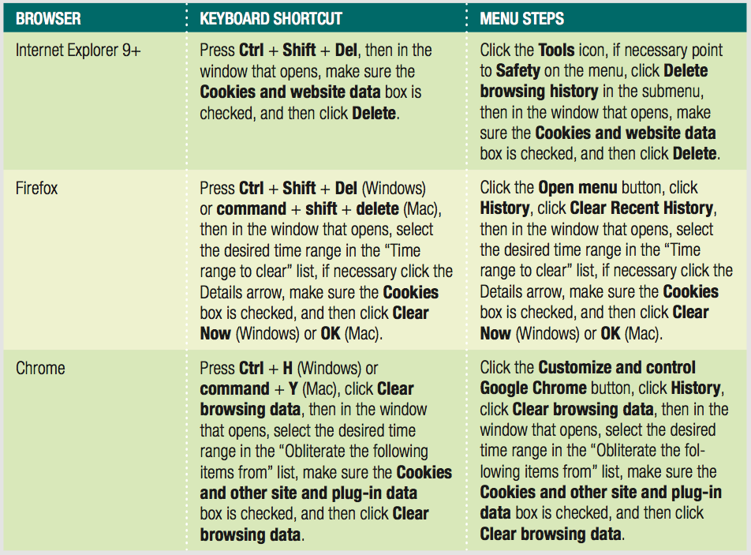
Deleting Cookies from Your Browser
Persistent cookies can interfere with testing
Good idea to delete cookies periodically
Table 9-2 Steps to delete cookies in IE, Firefox, and Chrome

Slide 41
Storing State Information with the Web Storage API (Application Program Interface)
Common uses of cookies was never originally planned (creating, reading, removing).
Web Storage
Draft specification of W3C
Not supported by some older browsers
Cookies are still the standard
Web Storage offers additional features
Applications targeted at specific browsers can use Web Storage

Slide 42
Storing State Information with the Web Storage API
Two Web Storage properties of Window object
localStorage
Remains until you run code to delete it
Similar to persistent cookies
sessionStorage
Removed automatically when user closes browser tab or window
Like temporary cookies

Slide 43
Storing State Information with the Web Storage API
Storing/reading data with Web Storage easier and more straightforward than cookies.
Example:
var firstName = document.getElementById("fname").value;
localStorage.fName = firstName;
To use a method
Preface it with localStorage or sessionStorage
localStorage.setItem(fname, firstName);

Slide 44
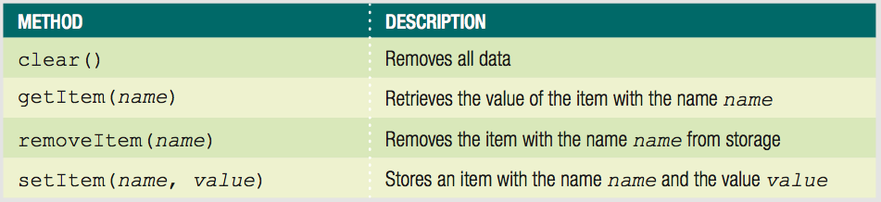
Storing State Information with the Web Storage API
Table 9-3 Methods of the Web Storage API

Slide 45
Short Quiz 2
What are the two main types of cookies? What is the difference between them?
How do you delete a cookie in your code?
What are some advantages of using Web Storage rather than cookies?
Why might a developer choose to continue using cookies?

Slide 46
Understanding Security Issues
Security threats
Viruses, worms, data theft by hackers
Consider web server security and secure coding issues
Web server security technologies
Firewalls
Secure Socket Layer (SSL)
JavaScript programs downloaded and execute locally

Slide 47
Secure Coding with JavaScript
Secure coding or defensive coding refers to writing code to minimize any intentional or accidental security issues.
All code: insecure unless proven otherwise
No magic formula for writing secure code.
$60 billion a year is spent identifying and correcting software errors.

Slide 48
JavaScript Security Concerns
Security areas of most concern:
Protection of a web page and JavaScript program against malicious tampering
Privacy of individual client information
Protection of the local file system of the client or web site from theft or tampering
Code injection attack
Program or user enters JavaScript code that changes function of web page
Validating forms helps prevent this
“Escaping” characters also important which involves converting characters to their code equivalents.

Slide 49
JavaScript Security Concerns
Another security concern
Privacy of individual client information in the web browser window
Another JavaScript security feature is its lack of certain types of functionality…
File manipulation cannot be done
Cannot create a network connection
Cannot run system commands or execute programs on a client

Slide 50
The Same Origin Policy
Restricts how JavaScript code access between windows/tabs/frames
To view and modify elements in other windows and frames
They must have the same protocol and exist on the same web server
Same origin policy applies to:
The domain name
The server on which a document located

Slide 51
The Same Origin Policy
Policy prevents:
Malicious scripts from modifying content of other windows and frames
Theft of private browser information and information displayed on secure web pages
Policy protects integrity of web page design

Slide 52
The Same Origin Policy
domain property of the Document object
Changes origin of a document to its root domain name
Allows documents from different origins in the same domain to access each other’s elements and properties

Slide 53
Using Third-Party Scripts
Sometimes you want to run scripts from other domains
Known as third-party scripts
Examples:
Widgets that run from provider's server
Using Content Delivery Network (CDN)
To enable third-party script
Include script element with src value pointing to third-party content
Exception to same origin policy

Slide 54
Short Quiz 3
What is a code injection attack?
What is the same origin policy?
What is a third-party script? How do you include one in a web document?

Slide 55
Summary
State information
Information about individual visits to a web site
HTTP originally designed to be stateless
Most common tools for maintaining state information:
Query strings, hidden form fields, cookies, Web Storage
Query string
Set of name-value pairs appended to a target URL
Can hide information from users in a hidden form field

Slide 56
Summary
Cookies
Small pieces of information about a user
Stored by a web server
Can be temporary or persistent
Cookie property created with a required name attribute
Can use special characters in cookies if using encoding
encodeURIComponent() function encodes the individual parts of a URI

Slide 57
Summary
When reading a cookie or other text string encoded
Must first decode it with the decodeURIComponent() function
Cookies: one continuous string that must be parsed
Web Storage similar to cookies
Offers more features, but not as widely supported
“Secure coding” or “defensive coding”
Writing code to minimize any intentional or accidental security issues

